Slide 1

Smart Home Project

Slide 2
Team members: Andrew Amgad Baraa Ahmed Merna Saeed Sondos Ahmed Yasmin Gamal

Slide 3


Introduction
Smart homes allow you to have greater home security and control of your energy use, all while automating things like adjusting temperature, turning lights on and off etc..

Slide 4
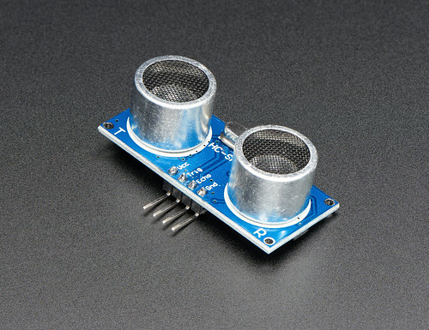




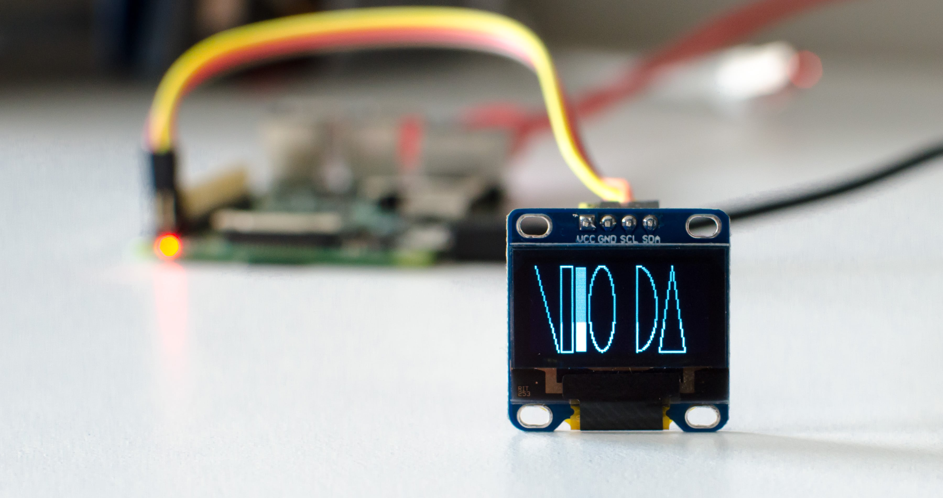
The Device Components
Fingerprint Sensor
OLED
RFID Sensor
Internal EEPROM
Servo Motor
Ultrasonic Sensors
Temperature Sensor
IOT
This Photo by Unknown Author is licensed under CC BY-SA-NC
This Photo by Unknown Author is licensed under CC BY-SA
This Photo by Unknown Author is licensed under CC BY-SA-NC
This Photo by Unknown Author is licensed under CC BY-NC
This Photo by Unknown Author is licensed under CC BY-SA-NC

Slide 5

Turn on the system
Turn on the system
Put Your Fingerprint
Matched
Yes
NO
Go To RFID Part

Slide 6
RFID First Read
RFID Check
Matched
Yes
NO
Start system

Slide 7
RFID Read Matched
Open Door
Open Leds With Ultarsonic
Adjust The Home’s Temprature
Then Send It Using IOT

Slide 8
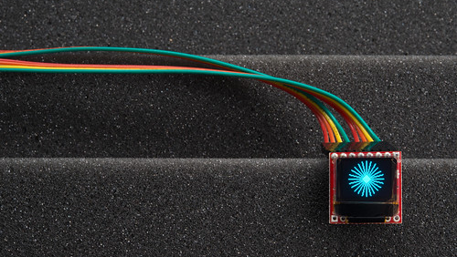
OLED
Organic Light Emitting Diode
Used For Displaying The System’s State
This Photo by Unknown Author is licensed under CC BY

Slide 9

FINGERPRINT
Used For Logging The System

Slide 10

RFID
Radio Frequency Identification
Allowing Accessing The System Features

Slide 11

Internal EEPROM
To Store The ID Of The RFID At The First Time

Slide 12

Temperature Sensor
Adjust The Home’s Temperature

Slide 13

Servo Motor
Open The Door When The ID Is Matched

Slide 14
Ultrasonic Sensors
Turning Lights On/Off Based On Number Of People
This Photo by Unknown Author is licensed under CC BY-SA-NC

Slide 15

IOT
Technologies Allow Devices To Exchange Data Over A Network

Slide 16
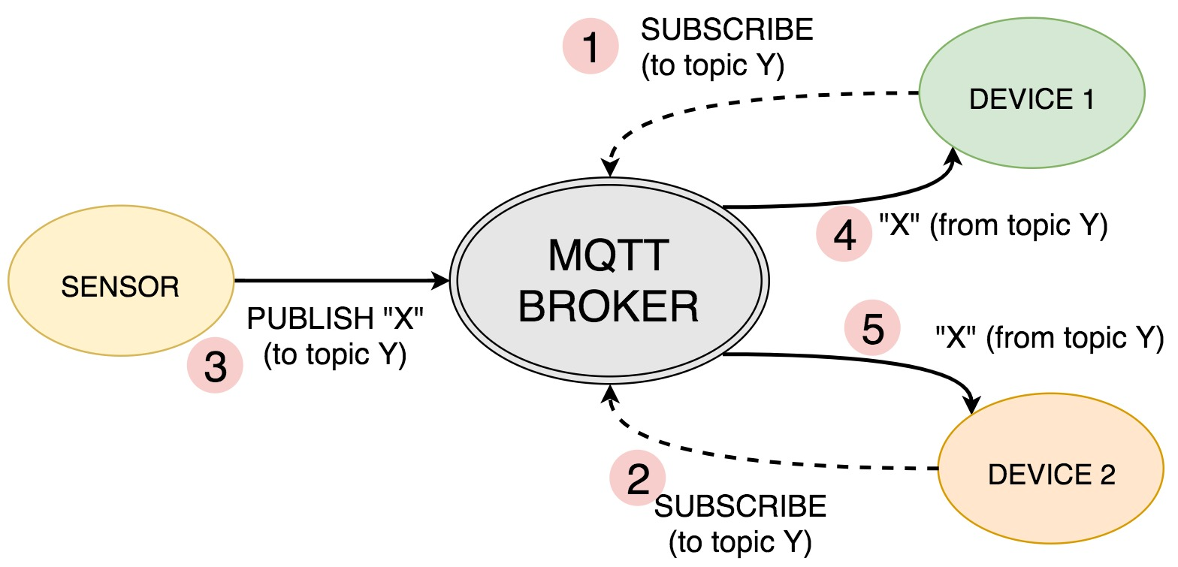
MQTT
.

Slide 17
IOT system
connect to Wi-Fi network
Send connect packet
Send publish packet
Send Subscribe packet

Slide 18

THANK YOU

